Slide 1
Main Mode

Slide 2
Age

Slide 3
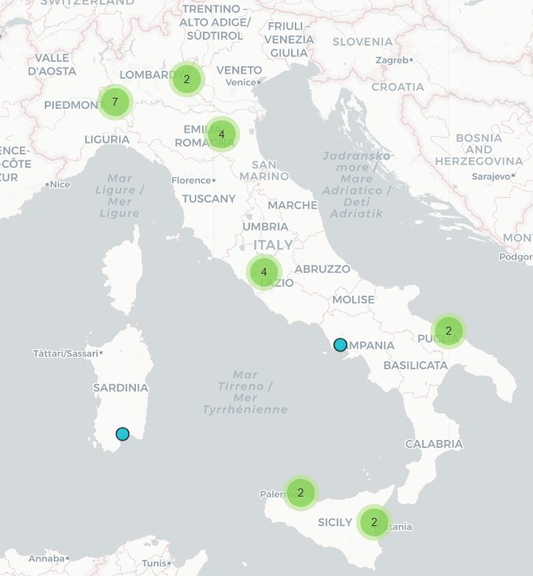
Office distribution

Slide 4
Satisfaction change in three years

